Slide 1






PRESENTATION 2026
Student Name
Student Email
Amtul Jaleel Ayesha
ayeshapari2007@gmail.com
Mentor Name
Ms.Umamaheswari

Slide 2
edunet
foundation
STUDENT PERFORMANCE PRISM

Slide 3
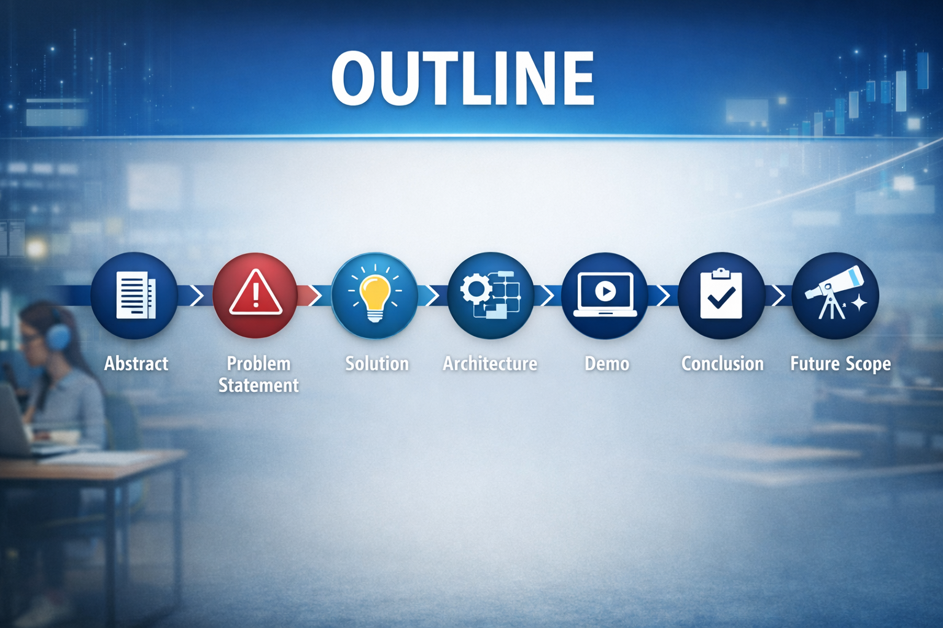
edunet
foundation

Slide 4

edunet
foundation
Abstract
This project focuses on analyzing student performance using data-driven techniques. It studies various factors that influence academic results, such as attendance, study habits, and other relevant parameters. The analysis helps in identifying patterns and trends in student performance.

Slide 5

edunet
foundation
Problem Statement
Delayed Reporting Cycles Performance reports are generated monthly or quarterly, meaning interventions happen too late to support struggling students in real time.
Static KPIs Without Context Institutions rely on fixed metrics (like pass rates) without dynamic filters or drill-downs, making it impossible to see which courses or student groups are driving the results.
Resource Allocation Blind Spots
Reactive Support Strategies
Manual Data Entry & Fragmentation

Slide 6

edunet
foundation
Proposed Solution
By applying structured data analysis and AI-driven techniques to transform raw student data into actionable insights.
The dashboard includes KPIs to measure performance. Cards display key values and also used DAX measures to calculate these values dynamically, ensuring real-time updates based on selections.
This enables early support strategies, better resource allocation, and improved academic results.

Slide 7
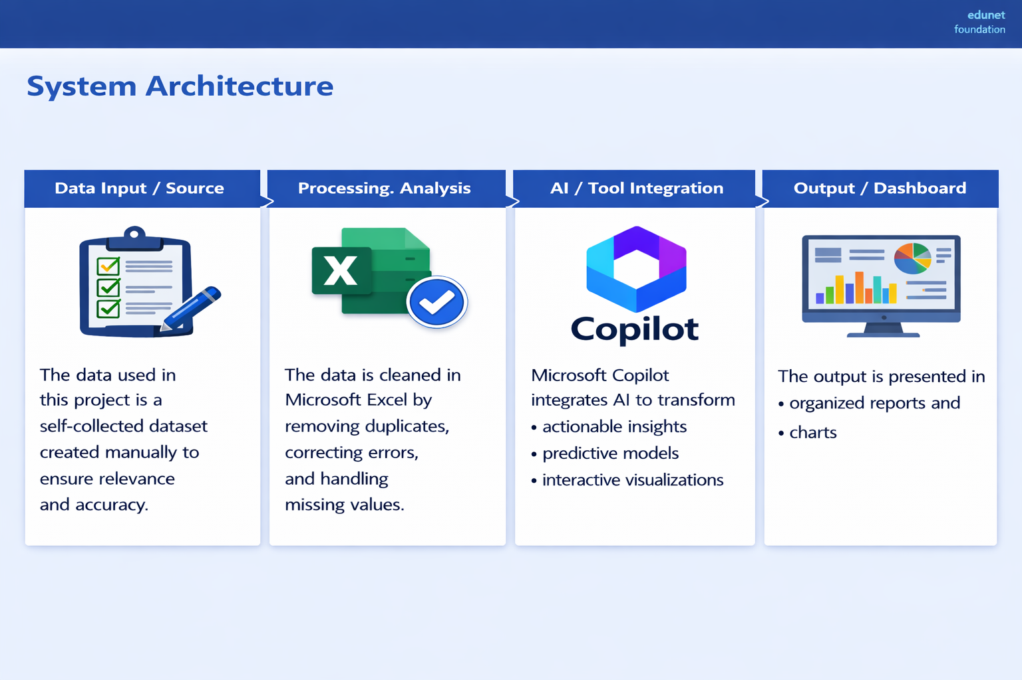
edunet
foundation
System Architecture
Data Input / Source
Processing / Analysis
The data used in this project is a self-collected dataset created manually to ensure relevance and accuracy.
The data is cleaned in Microsoft Excel by removing duplicates, correcting errors, and handling missing values.
AI / Tool Integration
Output / Dashboard
Microsoft Excel is used for data collection, cleaning, while Microsoft Copilot integrates AI to transform this prepared data into actionable insights, predictive models, and interactive visualizations that strengthen institutional decision-making
The final output of the project is presented in the form of organized reports, charts, and visual representations.

Slide 8
edunet
foundation
Live Demo of Project
🖼
🖼
🖼
GitHub
Video Presentation
https://github.com/ayeshapari2007-create/Student-Academic-Analysis-and-Grade
https://drive.google.com/file/d/1abRuCjyAY6DIBT8CqbmiCCmaPU4iVPTj/view?usp=drive_link

Slide 9

edunet
foundation
Conclusion
✅
• Abstract of the Project
This project successfully developed a structured system for analyzing student academic performance using semester-wise data, attendance, and key performance indicators. The visualizations I have built — from KPI cards that spotlight excellence to funnel and Bar charts that trace progression.
• Problem Statement
• Proposed Solution
• System Architecture
• Live Demo of the Project
• Embedded Video of Project
CONCLUSION
• Conclusion
• Future Scope

Slide 10

edunet
foundation
Future Scope
🧠
• Abstract of the Project
This project can be further enhanced by incorporating advanced analytical and technological features to improve its effectiveness and scalability. One key improvement is the integration of predictive analytics and machine learning models to forecast student performance and identify at-risk students more accurately at an early stage.
• Problem Statement
• Proposed Solution
• System Architecture
• Live Demo of the Project
• Embedded Video of Project
• Conclusion
[Future ideas & roadmap]
• Future Scope

Slide 11

edunet
foundation
Thank You
AICW Fellowship | Student Project Presentation 2026
LinkedIn | Edunet Foundation

